Slide 1
Machine learning for biology workshop
Fangzhou Mu
Chris Magnano
Anthony Gitter

Slide 2
After the workshop, you will…
Know what machine learning (ML) does and why it can be useful in biological research.
Be able to read papers that apply (simple) ML to biological problems.
Understand (some of) the language used by computational biologists and be more comfortable to collaborate with them.
Be prepared to explore opportunities of applying ML in your own projects.

Slide 3
We will cover…
An introduction to ML
Motivation
Tasks (we will focus on classification)
The basics of ML
ML vocabulary
Typical ML workflow
Some simple (but popular) classification models
Neural Networks, Random Forests, Support Vector Machines, Naïve Bayes …
Evaluation of classifier performance
Metrics
Plots
Hands-on practice with toy and real datasets

Slide 4
We will NOT cover…
Coding
We will click on buttons in a user-friendly software.
Math
Math only appears when it is absolutely needed.
We will focus on intuition, not calculation.
Feature engineering
We primarily study the “core” of ML.
However, engineering tricks are critical to the success of ML in practice.
Highly domain specific, a lot of folk wisdom, no universal guideline, coding required.
The state-of-the-art models at the frontier of ML/bioinformatics research
Beyond the scope of a half-day workshop

Slide 5
Brainstorming! What types of data do you generate in the lab? What would you want to learn from your data?
Practice

Slide 6

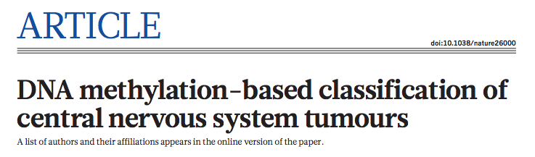
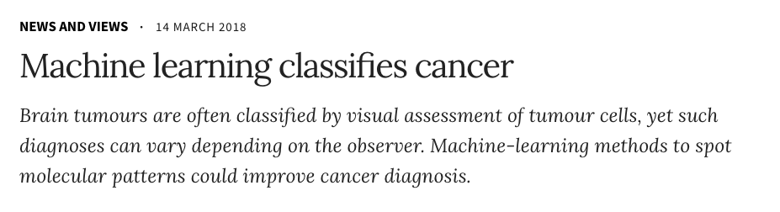
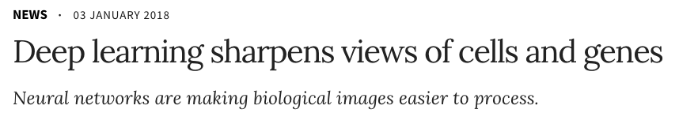
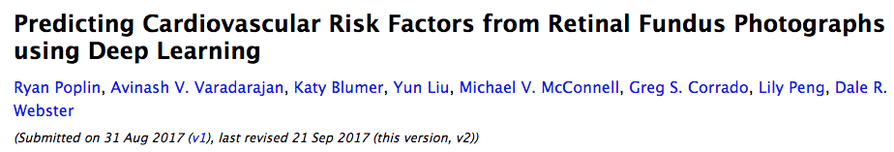
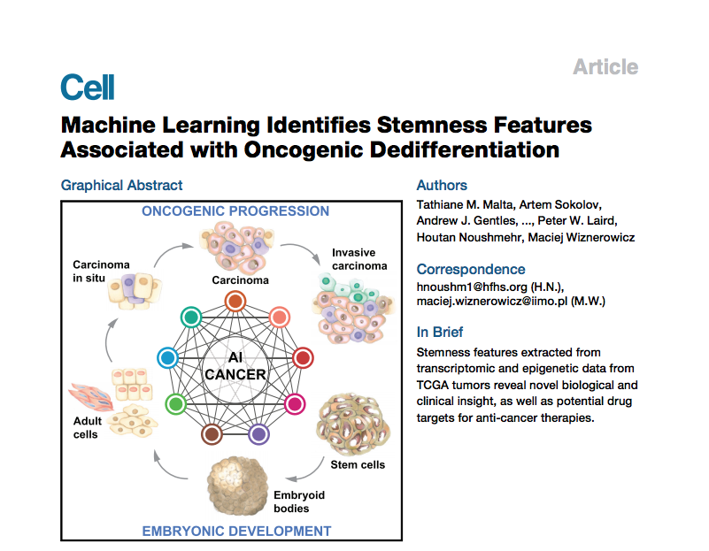
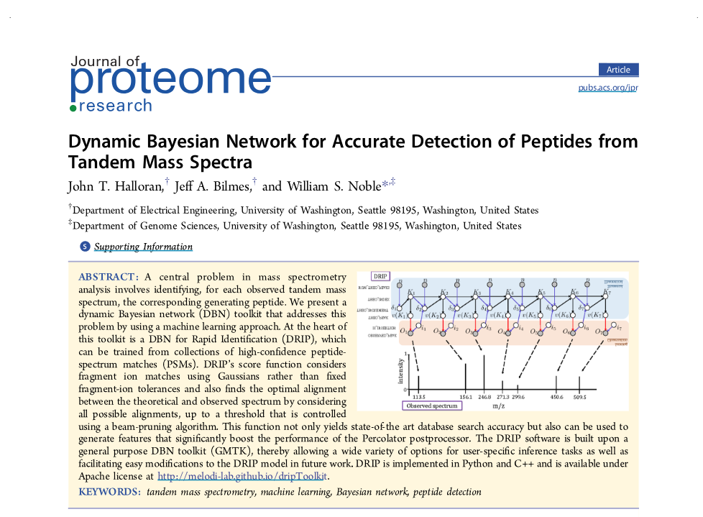
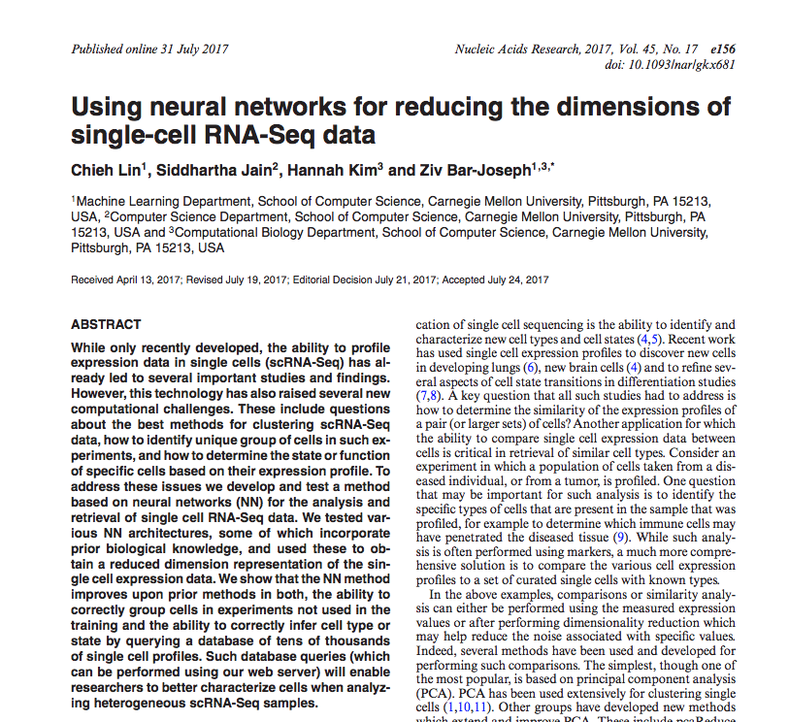
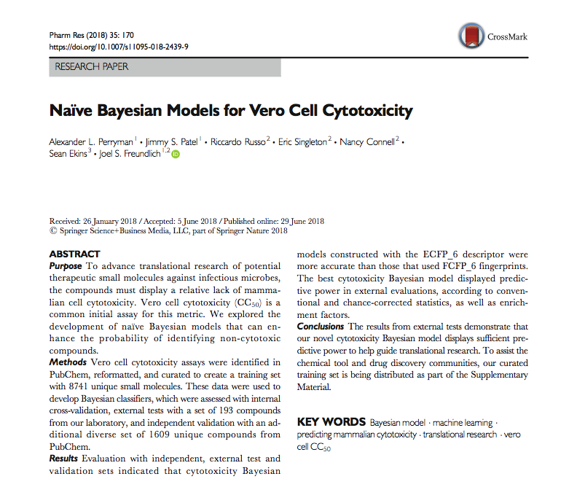
ML in biology
Nature. 2018 Mar 22;555(7697):469-474.
https://www.nature.com/articles/d41586-018-02881-7
https://www.nature.com/articles/d41586-018-00004-w
arXiv:1708.09843v2 [cs.CV]
Cell. 2018 Apr 5;173(2):338-354.e15.
Nucleic Acids Res. 2017 Sep 29;45(17):e156.
J Proteome Res. 2016 Aug 5;15(8):2749-59.
Pharm Res. 2018 Jun 29;35(9):170.

Slide 7

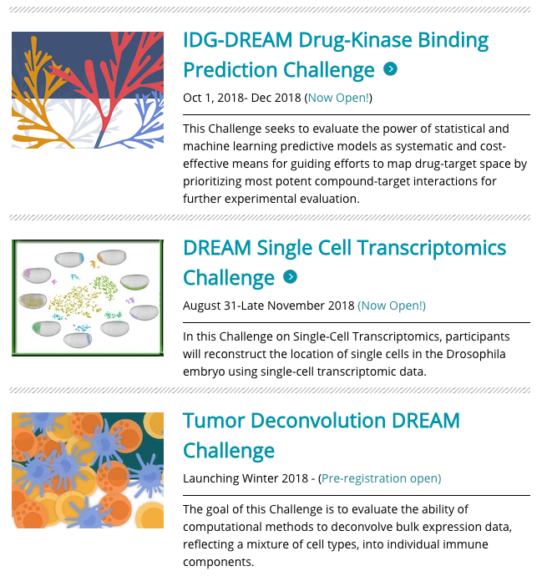
ML in biology
dreamchallenge.org

Slide 8
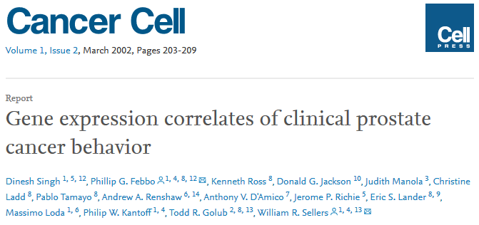
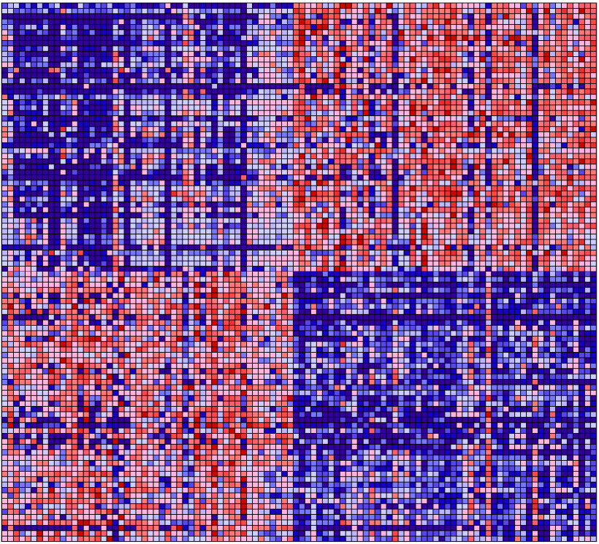
ML in biology
Samples:
52 prostate tumor and 50 normal prostate specimens taken from patients undergoing surgery
Features:
Expression data from oligonucleotide microarrays of ~12,600 genes.
Labels:
Tumor or normal tissue
Classifier:
kNN Classifier was over 90% accurate using small subset of genes
Normal
Tumor
Further preprocessing done by Optimization Based Tumor Classification from Microarray Gene Expression Data .
Dagliyan O, Uney-Yuksektepe F, Kavakli IH, Turkay M (2011). PLOS ONE 6(2): e14579.

Slide 9
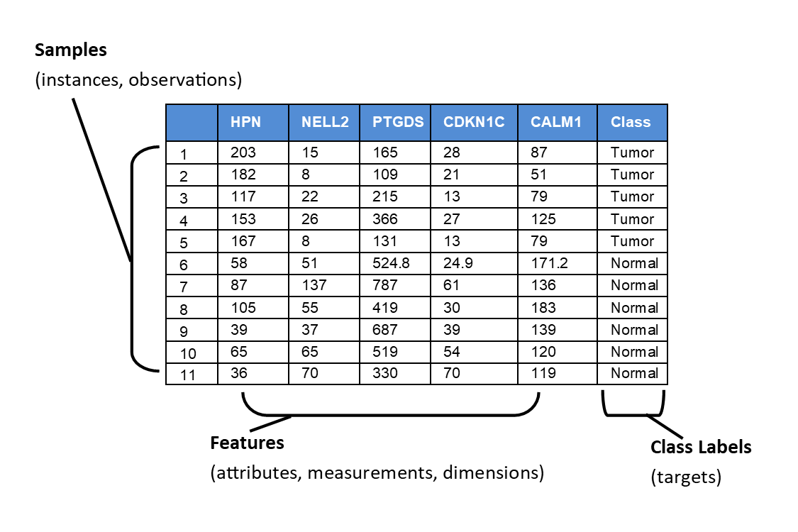
Dataset
Figure adapted from
https://github.com/rasbt/python-machine-learning-book-2nd-edition
S. Raschka and V. Mirjalili, Python Machine Learning (2nd Ed.)

Slide 10
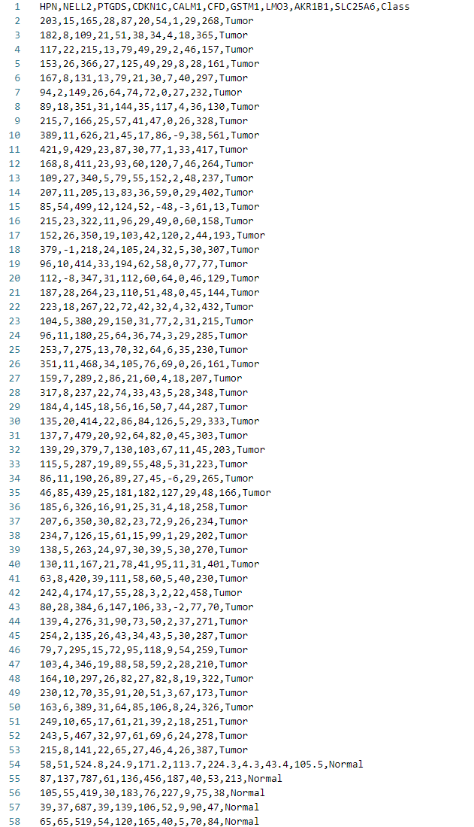
Dataset
A typical .csv file:

Slide 11
Dataset Open the telomere ALT dataset telomere.csv. What do the rows represent? What are the features? How many classes are there?
Practice

Slide 12
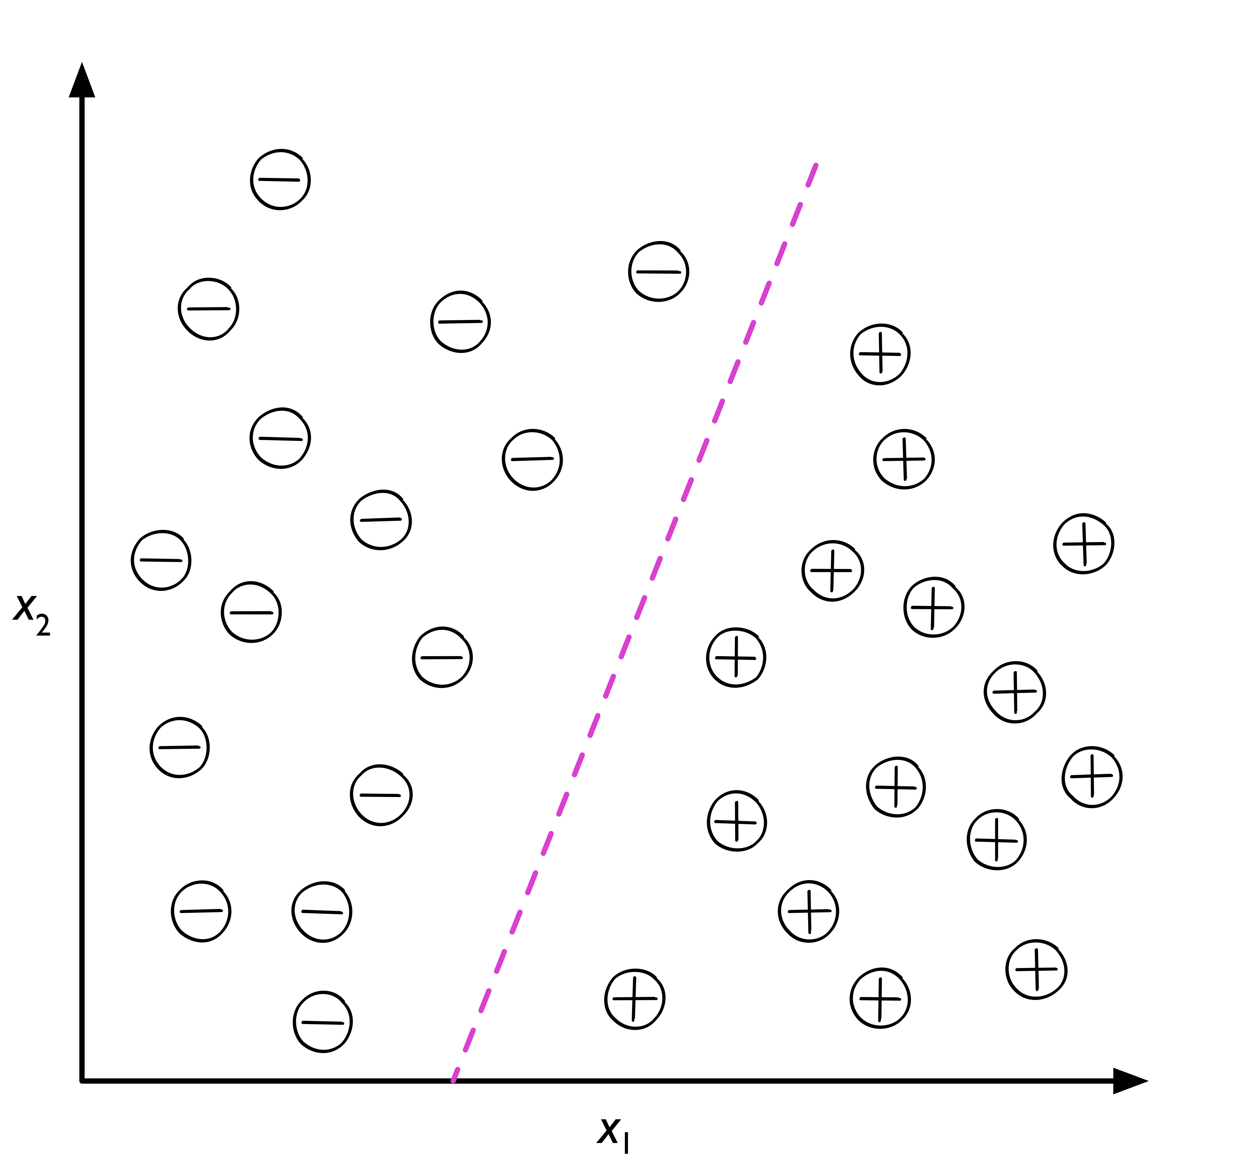
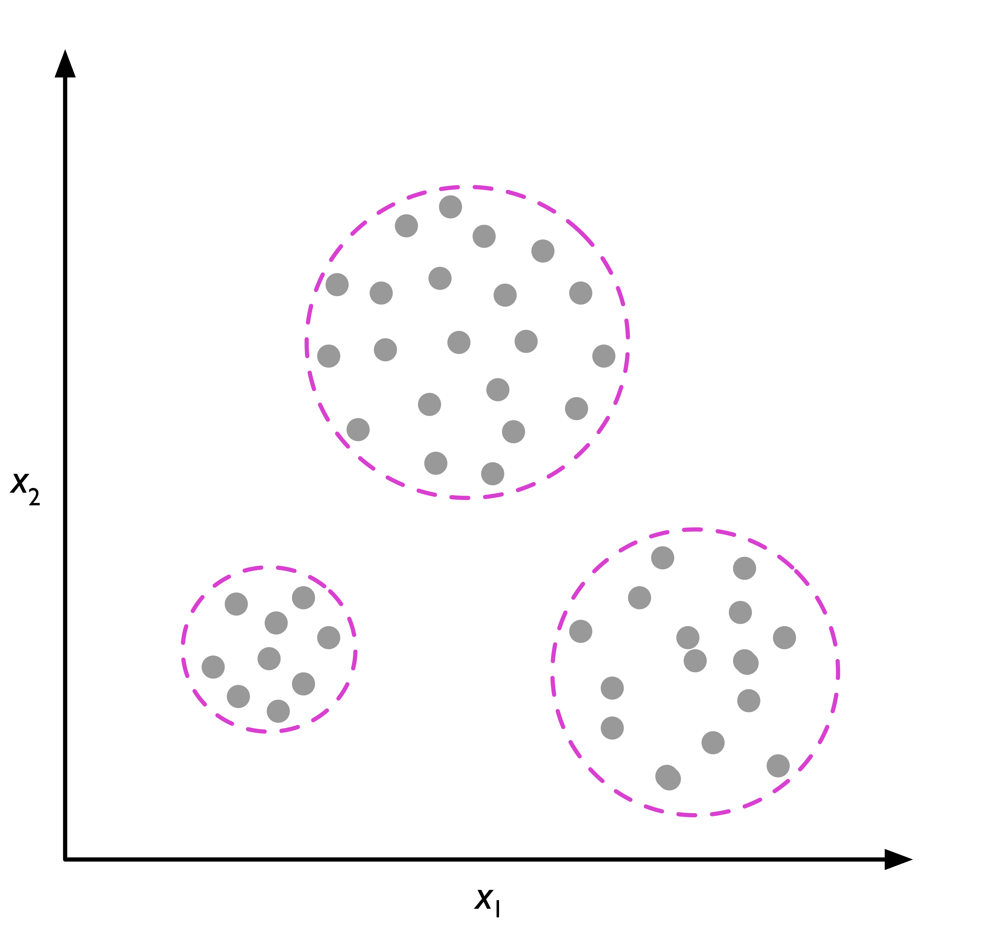
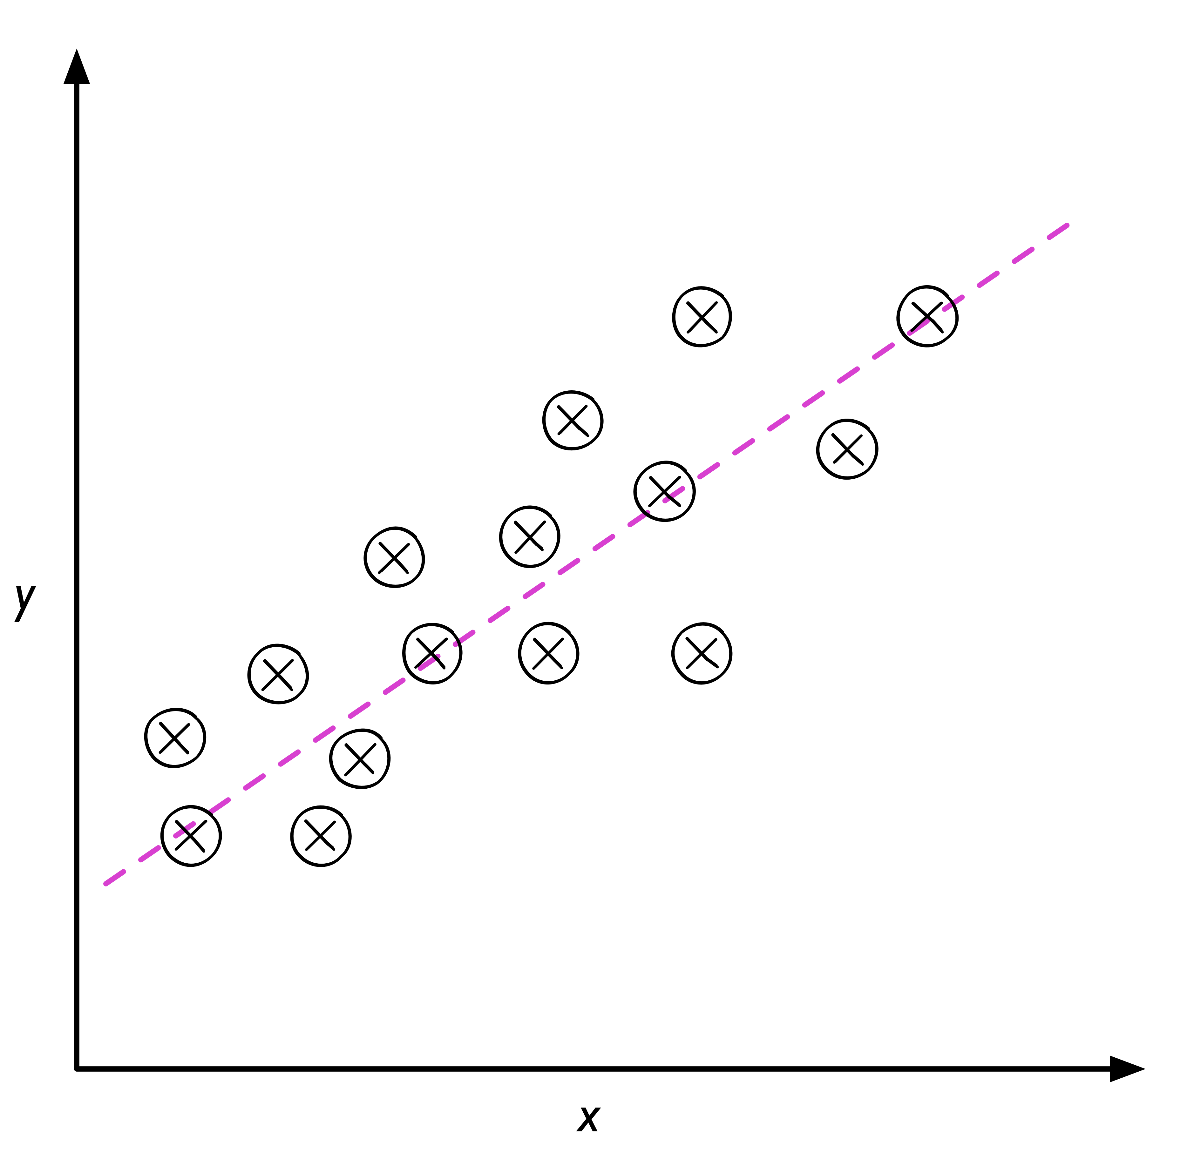
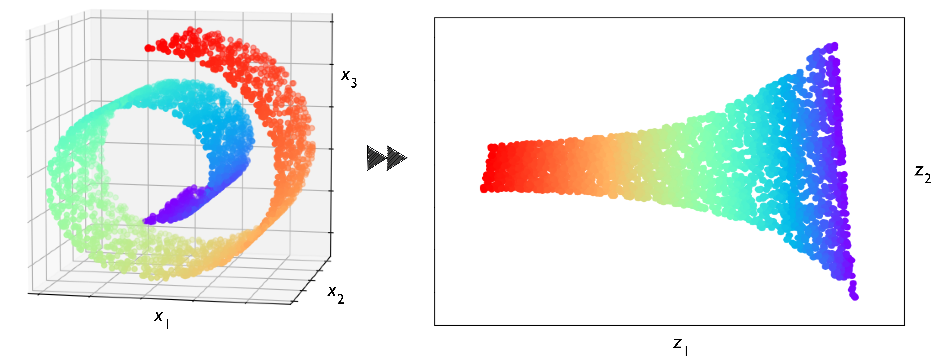
ML tasks
Supervised learning
Unsupervised learning
Classification
Clustering
Regression
Dimensionality reduction
Figures from
https://github.com/rasbt/python-machine-learning-book-2nd-edition
S. Raschka and V. Mirjalili, Python Machine Learning (2nd Ed.)

Slide 13
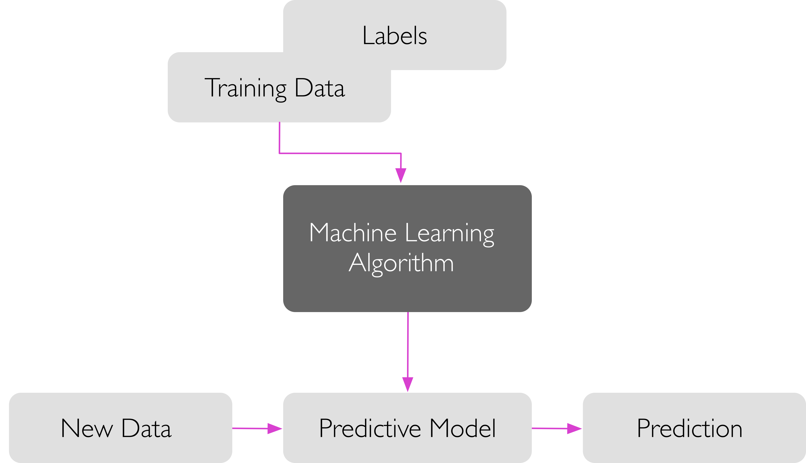
Models: Training and Inference
Training
Inference
Figure from
https://github.com/rasbt/python-machine-learning-book-2nd-edition
S. Raschka and V. Mirjalili, Python Machine Learning (2nd Ed.)

Slide 14
ML workflow
Figure from
https://github.com/rasbt/python-machine-learning-book-2nd-edition
S. Raschka and V. Mirjalili, Python Machine Learning (2nd Ed.)

Slide 15
Get your hands dirty! Load prostate.csv. Train some classifiers of your choice. Predict labels for new data.
Practice

Slide 16
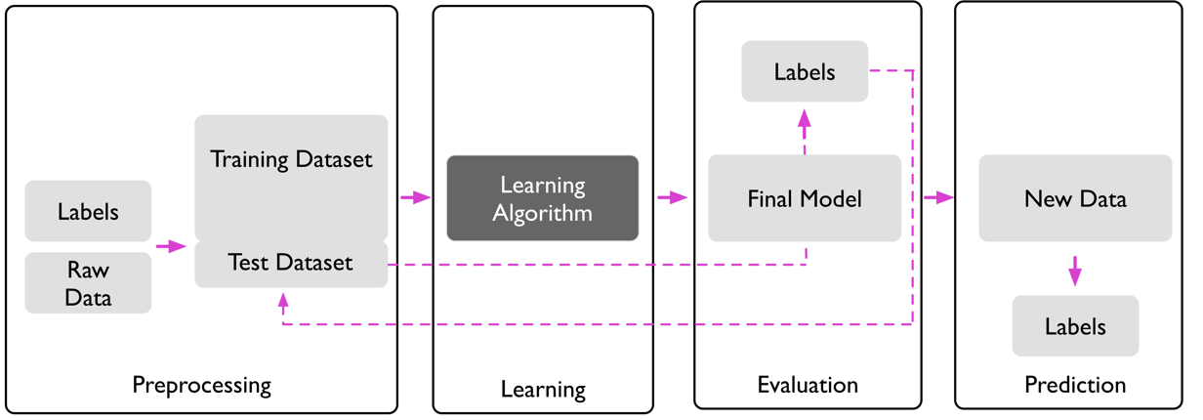
Step 1: Preprocessing
Figure from
https://github.com/rasbt/python-machine-learning-book-2nd-edition
S. Raschka and V. Mirjalili, Python Machine Learning (2nd Ed.)

Slide 17
Step 1: Preprocessing
Before training a classifier, raw data needs to be
Transformed (images, sequences, text, spectra)
Cleaned (missing values, typos, inconsistency)
Combined (date from different sources/modalities)
Normalized (batch effect, features in different scales)
Encoded (categorical features)
Feature engineering
Feature selection

Slide 18
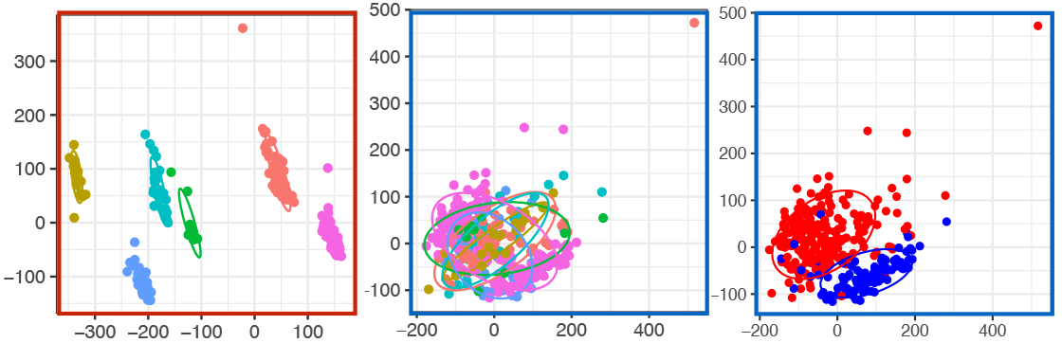
Data normalization
Raw Data
After Processing by Combat
Colored by Dataset
Colored by Dataset
Colored by Disease Status
PC2
PC1
Su Bin Lim, Swee Jin Tan, Wan-Teck Lim, Chwee Teck Lim.
Compendiums of Cancer Transcriptome for Machine Learning Applications
BioRxiv 353698 [Preprint]. June 22, 2018 Available from: https://doi.org/10.1101/353698

Slide 19
Data encoding
shape | size | extravasation | class
bean | small | yes | cancer
oval | large | yes | normal
bean | small | no | cancer
round | medium | no | normal
oval | medium | no | cancer
bean | oval | round
1 | 0 | 0
0 | 1 | 0
1 | 0 | 0
0 | 0 | 1
0 | 1 | 0
size
0
2
0
1
1
extravasation
1
1
0
0
0
class
1
0
1
0
1
One-hot encoding
Integer encoding

Slide 20
Data Preprocessing Discussion What methods or tools have you used for data normalization and preprocessing? What assumptions are made when normalizing and preprocessing data?
Practice

Slide 21
Step 2: Learning
Figure from
https://github.com/rasbt/python-machine-learning-book-2nd-edition
S. Raschka and V. Mirjalili, Python Machine Learning (2nd Ed.)

Slide 22
Step 2: Learning
Training
Choose classifier type
Set hyperparameters (if applicable)
Apply a learning algorithm
Validation
Estimate classifier performance
Hyperparameter optimization
Classifier selection

Slide 23

Training
Classifier types
Logistic Regression
Neural Networks
Decision Trees
Random Forests
Support Vector Machine (SVM)
K-Nearest Neighbors (if time permits)
Naïve Bayes (if time permits)
Learning algorithms
Optimization of an objective function
A lot of math behind
Figure from
https://blog.paperspace.com/intro-to-optimization-in-deep-learning-gradient-descent
A. Kathuria, Intro to optimization in deep learning: Gradient Descent

Slide 24
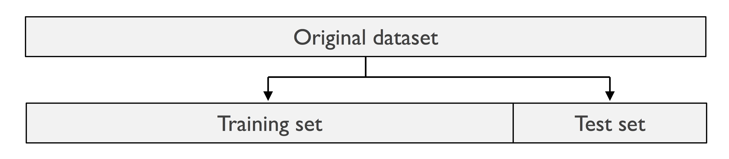
Train/test split
Figure adapted from
https://github.com/rasbt/python-machine-learning-book-2nd-edition
S. Raschka and V. Mirjalili, Python Machine Learning (2nd Ed.)

Slide 25
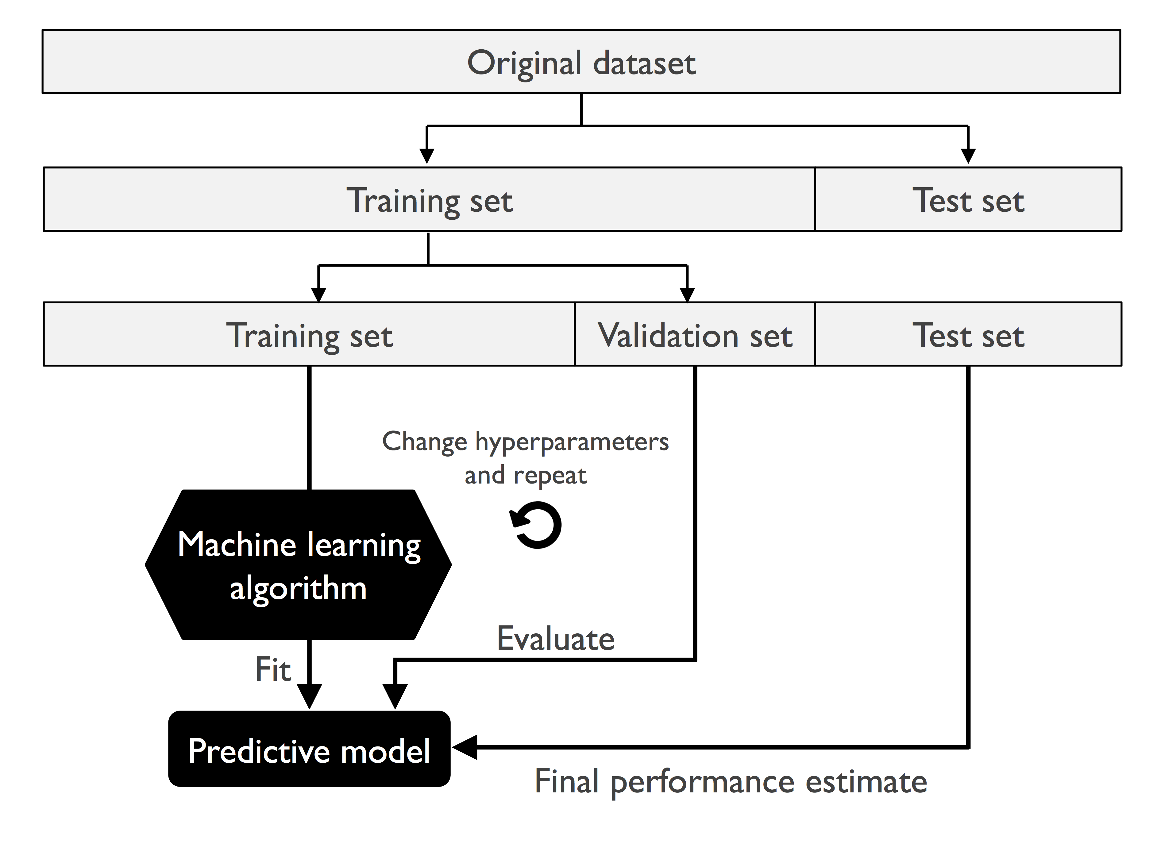
Validation
Hold-out validation
Figure from
https://github.com/rasbt/python-machine-learning-book-2nd-edition
S. Raschka and V. Mirjalili, Python Machine Learning (2nd Ed.)

Slide 26
Validation & Overfitting Experiment on toy_data_6.csv. Hold out 20% data for validation. Train an SVM with the following settings: (a) kernel=‘rbf’, gamma=0.5 (b) kernel=‘rbf’, gamma=10 How well does training accuracy agree with validation accuracy? Why? (Hint: check the decision boundary) Hold out 0% data for validation (i.e. no validation set). Train an SVM with setting (b) above. How well does training accuracy agree with test accuracy? Why is the validation set important?
Practice

Slide 27
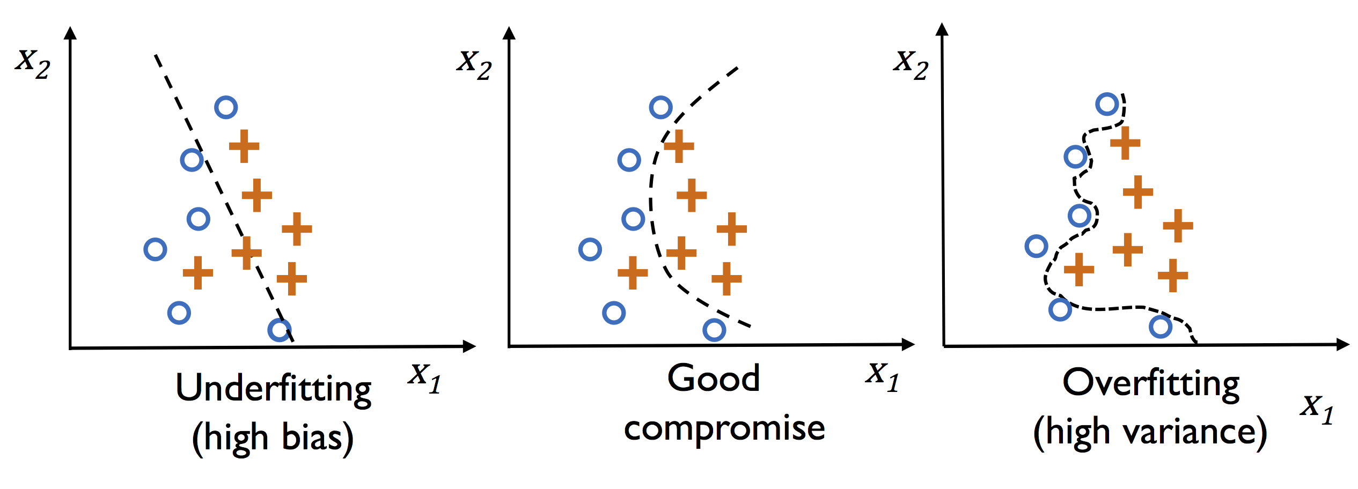
Underfitting and Overfitting
Figure from
https://github.com/rasbt/python-machine-learning-book-2nd-edition
S. Raschka and V. Mirjalili, Python Machine Learning (2nd Ed.)

Slide 28
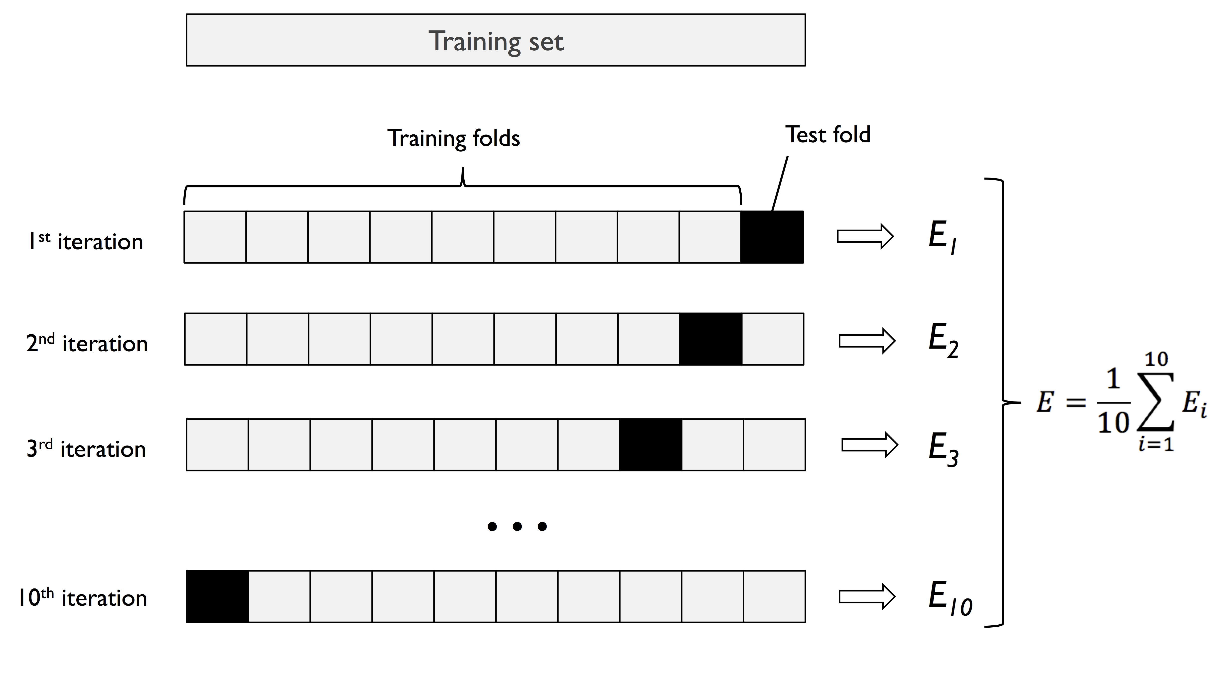
Validation
K-fold cross-validation
(fold: the number of subsets the training set is divided evenly into)
K = 10
Figure from
https://github.com/rasbt/python-machine-learning-book-2nd-edition
S. Raschka and V. Mirjalili, Python Machine Learning (2nd Ed.)

Slide 29
Data splitting Experiment on toy_data_4.csv and toy_data_5.csv. (a) Vary size of validation set in hold-out validation. (b) Vary K in K-fold variation. Train an SVM with default setting. When does training accuracy best agree with validation accuracy?
Practice

Slide 30
Step 3: Evaluation
Figure from
https://github.com/rasbt/python-machine-learning-book-2nd-edition
S. Raschka and V. Mirjalili, Python Machine Learning (2nd Ed.)

Slide 31
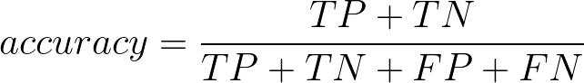
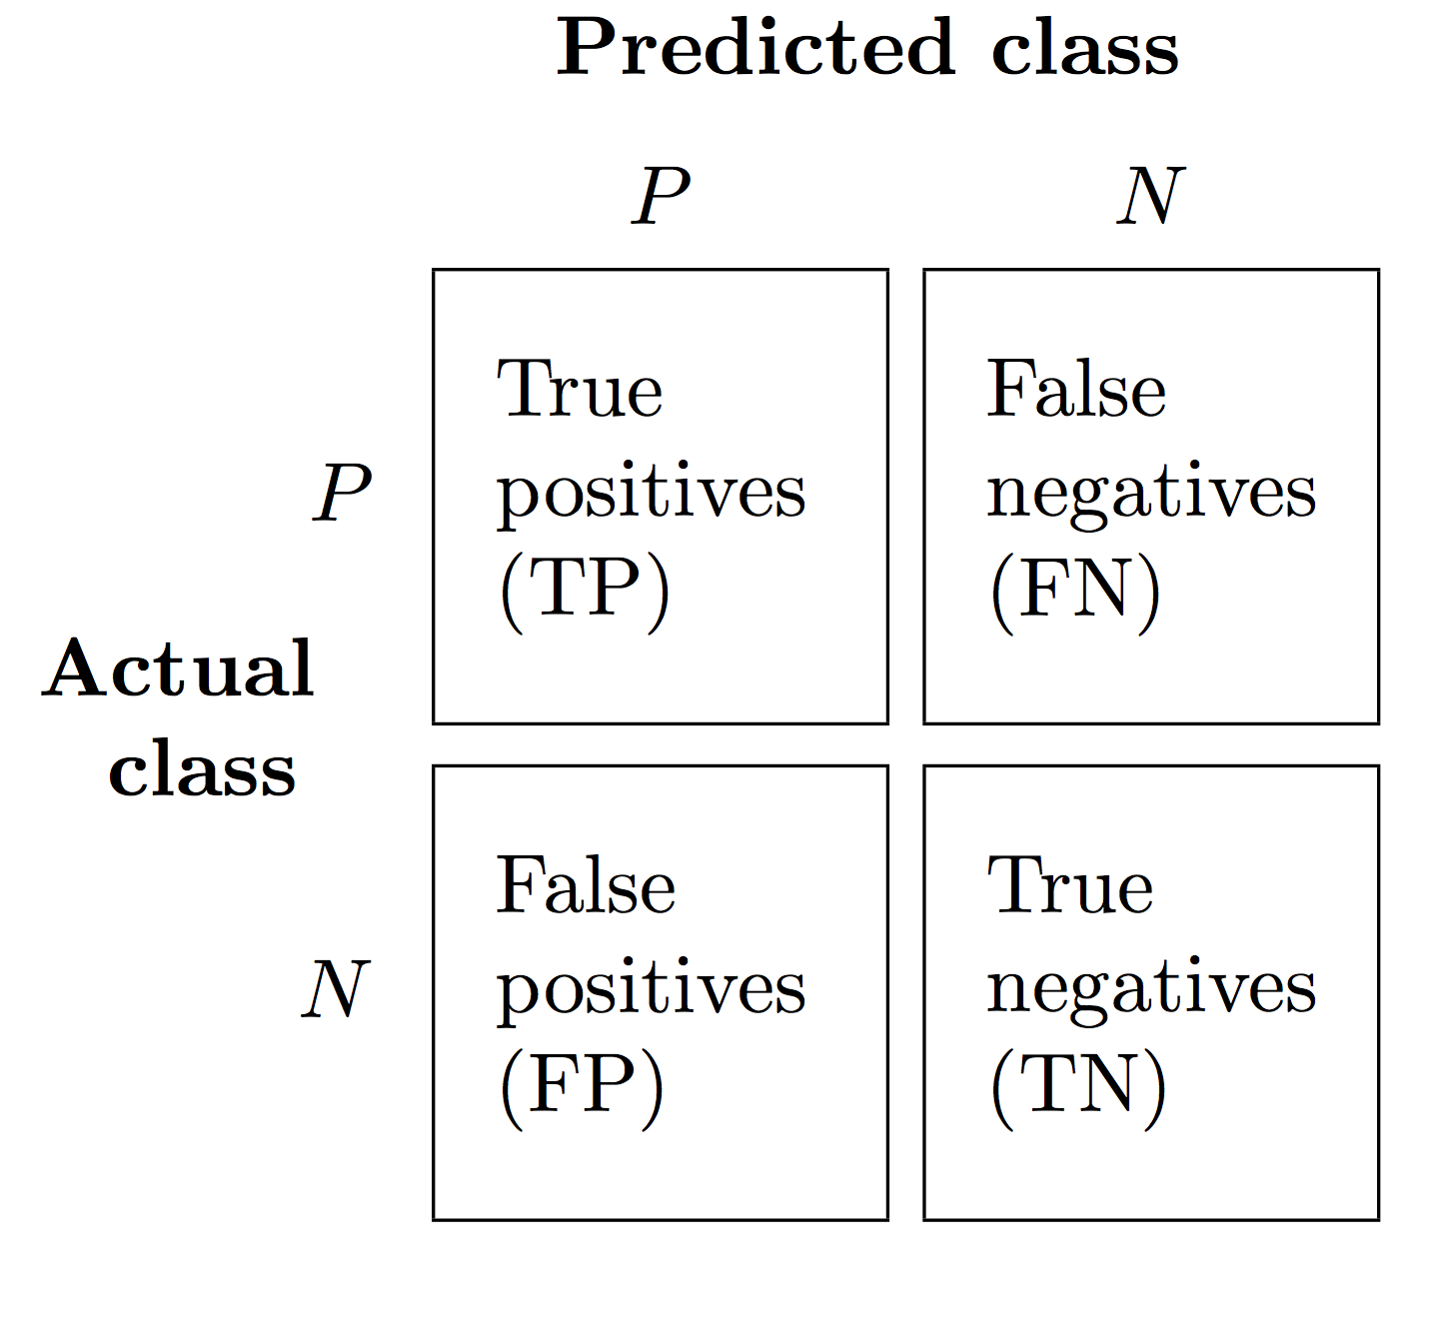
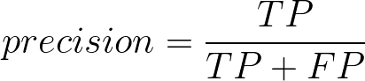
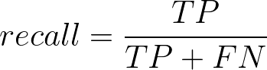
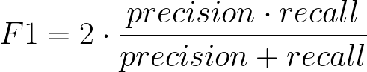
Performance Metrics
Figure from
https://github.com/rasbt/python-machine-learning-book-2nd-edition
S. Raschka and V. Mirjalili, Python Machine Learning (2nd Ed.)

Slide 32
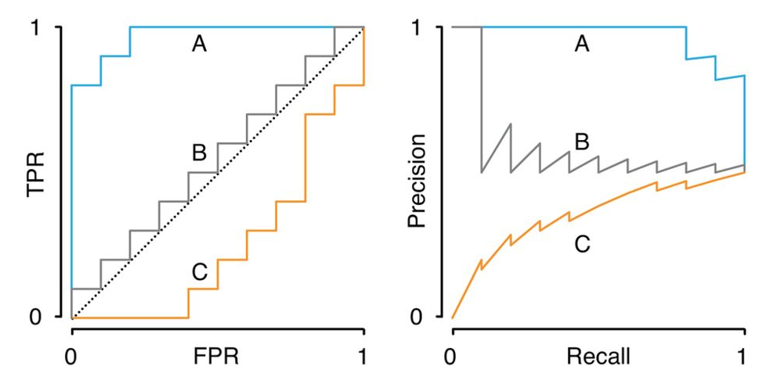
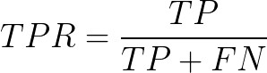
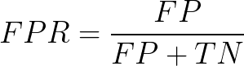
Plots
Receiver operating characteristic (ROC) curve
Precision-recall (PR) curve
A: better than random
B: close to random
C: worse than random
Figure from
Classification evaluation
J. Lever, M. Krzywinski & N. Altman, Nature Methods volume 13, pages 603–604 (2016)

Slide 33
Performance Compute accuracy, precision, recall and F1. Experiment on toy_data_2.csv and toy_data_9.csv. Train a logistic regression classifier with default setting. What accuracy do you achieve? How about precision and recall? How good is your classifier? Think about when accuracy is not a good measure of performance, and why precision and recall are helpful.
Practice
Sample | True class | Predicted class
1 | + | +
2 | + | +
3 | - | +
4 | + | +
5 | - | -
6 | - | -
7 | + | +
8 | + | -
9 | + | +
10 | - | +

Slide 34
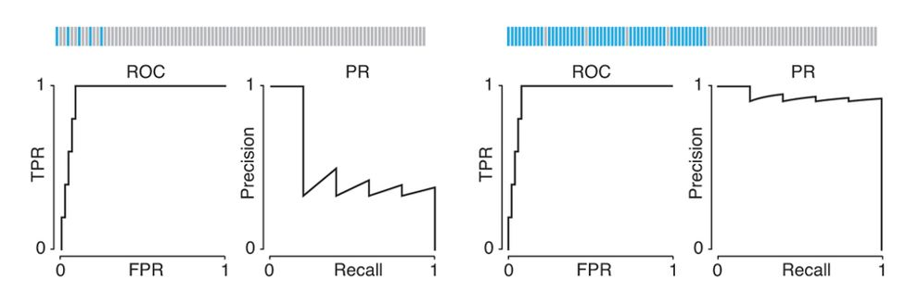
More on Plots
Class imbalance can cause ROC curves to be poor visualizations of classifier performance.
Which curve is more informative?
Figure from
Classification evaluation
J. Lever, M. Krzywinski & N. Altman, Nature Methods volume 13, pages 603–604 (2016)

Slide 35
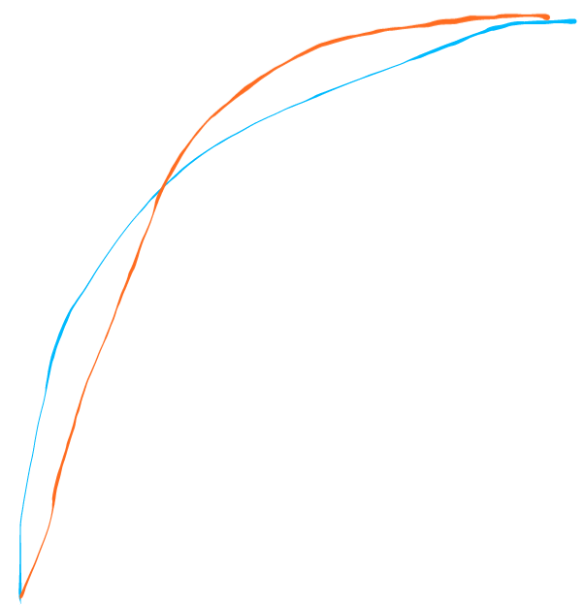
More on Plots
A classification problem can sometimes be cost-sensitive.
Use ROC curve to pick a decision threshold.
FN costs more than FP
FN and FP cost equally
FP costs more than FN
Classifier A
Classifier B
Which classifier is better?

Slide 36
Step 3: Evaluation
Why do we only evaluate on the test set one time?

Slide 37
Step 4: Prediction
Image from
https://github.com/rasbt/python-machine-learning-book-2nd-edition
S. Raschka and V. Mirjalili, Python Machine Learning (2nd Ed.)

Slide 38
Step 4: Prediction
Trained models can make predictions on new unlabeled samples

Slide 39
Classifiers
Now let’s learn some classifiers!
Classifier types
Logistic Regression
Neural Networks
Decision Trees
Random Forests
Support Vector Machine (SVM)
K-Nearest Neighbors (if time permits)
Naïve Bayes (if time permits)

Slide 40
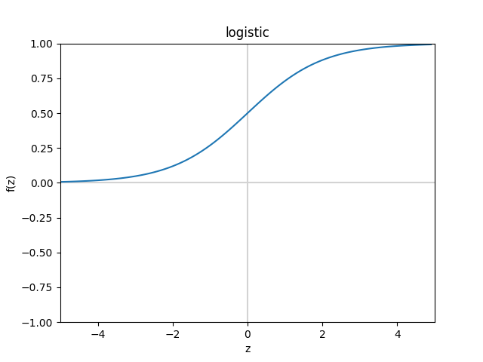
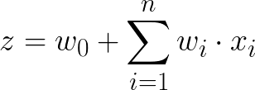
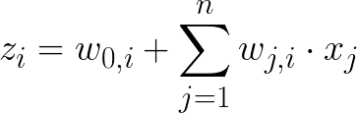
Logistic Regression: Representations and Inference
1
w₀
x₁
w₁
w₂
z
logistic
0.86
Binary setting
x₂
w_{n}
…
x_{n}
1
z₁
0.76
x₁
z₂
softmax
0.05
Multi-class setting
(e.g. 3 classes)
x₂
…
z₃
0.19
x_{n}

Slide 41
Logistic Regression: Example on Inference
1
-2
0.4
1.5
-0.5
3
logistic
0.95
0.2
5
0.9

Slide 42
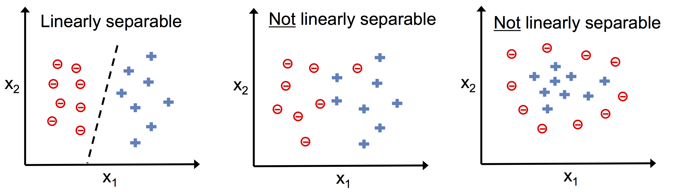
Linearly Separable vs. Not Linearly Separable
Image from
https://github.com/rasbt/python-machine-learning-book-2nd-edition
S. Raschka and V. Mirjalili, Python Machine Learning (2nd Ed.)

Slide 43
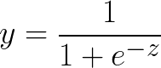
Logistic Regression & Linear separability Experiment on toy_data_3.csv and toy_data_8.csv. Logistic regression is a linear classifier. Why? (Hint: logistic function)
Practice

Slide 44
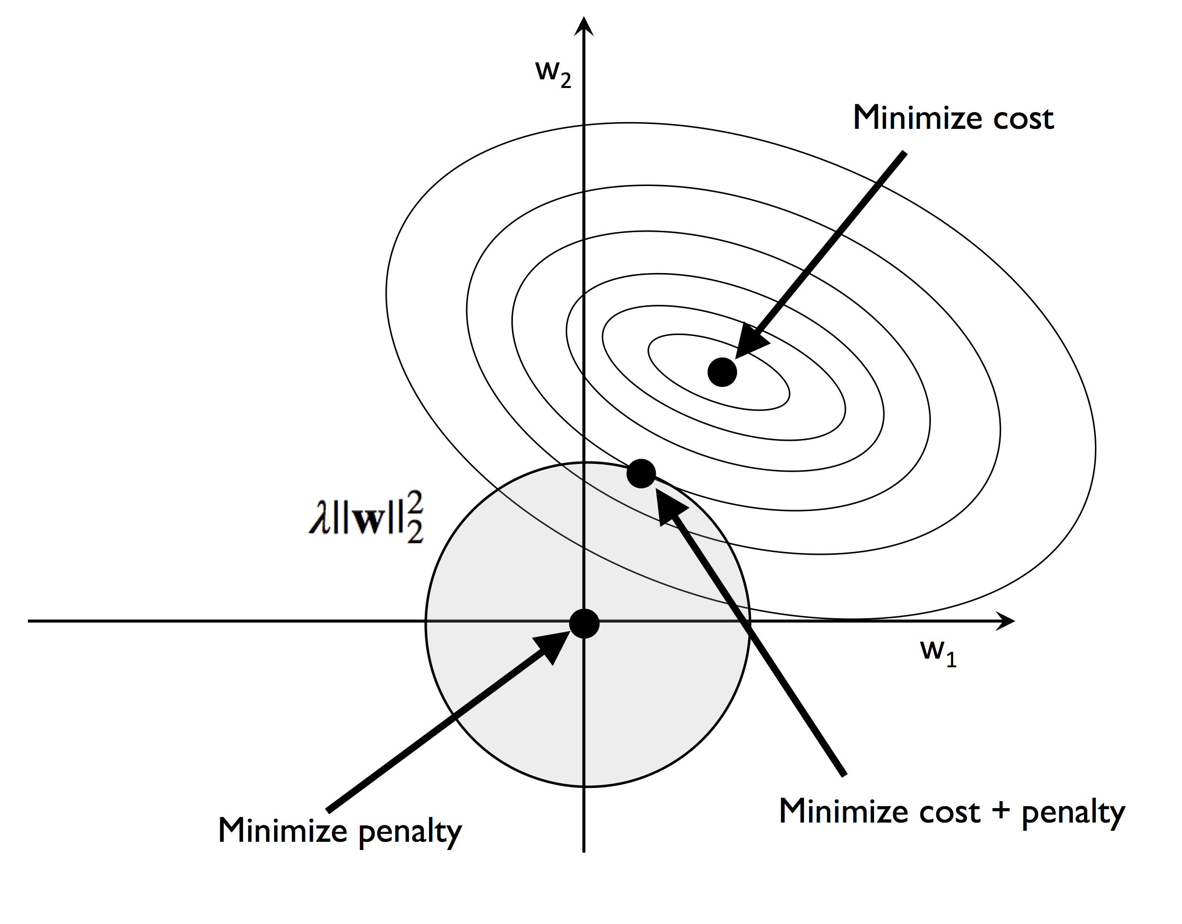
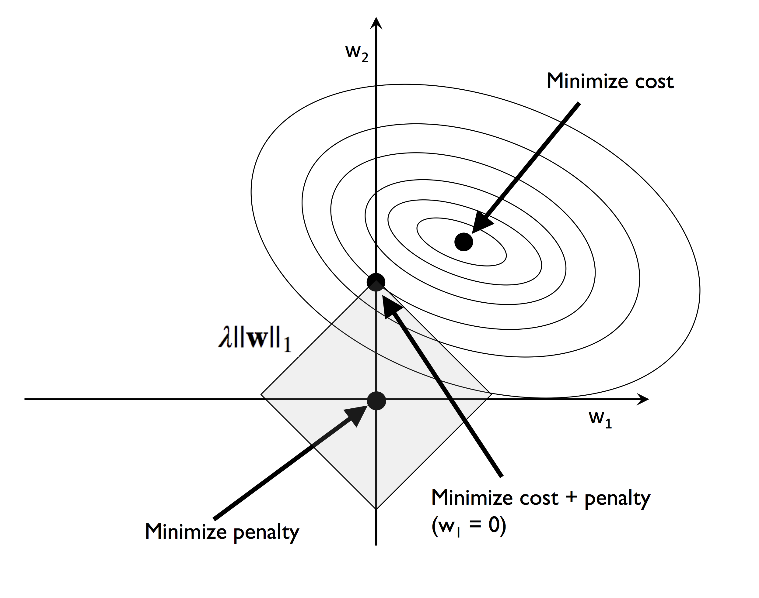
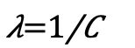
Regularization
L2 regularization (Ridge):
L1 regularization (Lasso):
Images from
https://github.com/rasbt/python-machine-learning-book-2nd-edition
S. Raschka and V. Mirjalili, Python Machine Learning (2nd Ed.)

Slide 45
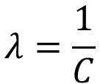
Regularization Experiment on toy_data_1.csv. First, set penalty to ‘L1’. Experiment with C = 0.08, 0.1, 0.2, 0.5, 1. Next, set penalty to ‘L2’. Experiment with the same set of C. Think about the difference. Examine the decision boundary and explain what you observe. (Recall: C is the inverse of regularization strength)
Practice
$$λ=\frac{1}{C}$$

Slide 46
Neural Network: Representations
1
1
x₁
a₁
c₁
z
logistic
0.73
Binary
x₂
activation function
(linear, relu, logistic, tanh)
a₂
c₂
…
x_{n}
a₃
c₃
Input layer
Hidden layer
Output layer
Prediction

Slide 47
Neural Network: Representations
1
1
z₁
0.09
x₁
a₁
c₁
z₂
0.05
softmax
Multiclass
(e.g. 4 classes)
x₂
activation function
(linear, relu, logistic, tanh)
a₂
c₂
z₃
0.62
…
x_{n}
a₃
c₃
z₄
0.24
Input layer
Hidden layer
Output layer
Prediction

Slide 48
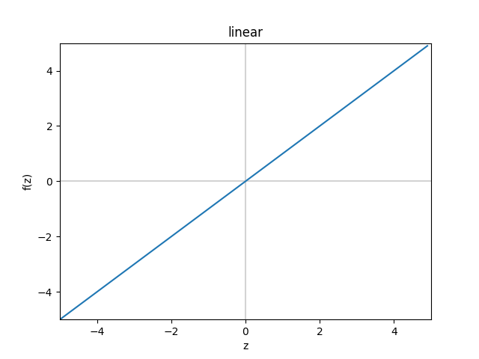
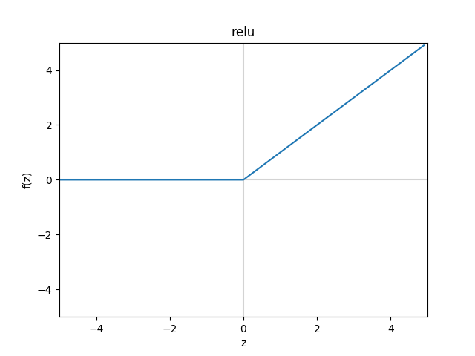
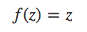
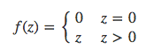
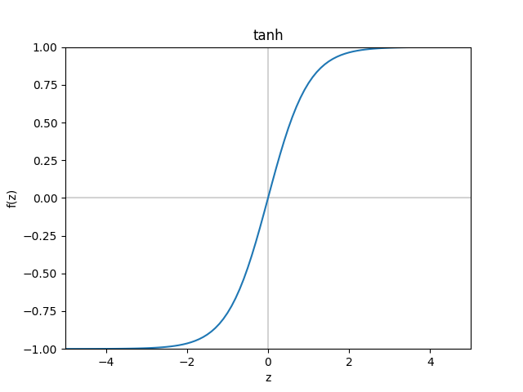
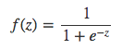
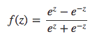
Neural Network: Activation Functions
identity (linear)
relu
logistic (sigmoid)
tanh

Slide 49
Neural Networks & Linear separability Experiment on toy_data_3.csv and toy_data_8.csv. What activation functions make a neural network a nonlinear classifier? Why? (Hint: you may want to try different solvers.)
Practice

Slide 50



Logistic Regression & Neural Network: Learning
Binary problem:
Cross-entropy loss
L2 regularization
Multiclass problem:

Slide 51
Neural Networks Structure & Learning Experiment on toy_data_5.csv and toy_data_8.csv. Consider the following settings. (a) solver = ‘lbfgs’, activation = ‘tanh’, alpha = 0.2. Experiment with num_hidden_units = 5, 10, 20, 50, 100. Examine accuracy and decision boundary. What do you observe? (b) num_hidden_units = 20, alpha = 0.2. Use different combinations of activation function and solver. Do they produce the same classifier? Why? (Hint: local minima)
Practice

Slide 52
Decision Tree: Representation and Inference
Decision tree to predict heart disease risk
Exercises
no
yes
Age
No
< 30
≥ 30
Internal node
No
BMI
< 25.5
≥ 25.5
Leaf node
No
Yes

Slide 53












Decision Tree: Learning
Feature set
Classes
Measure of uncertainty:
Gini
Given training data of size at node ,
Entropy
For feature :
where
Split with feature that reduces uncertainty
the most:

Slide 54
Decision Tree: Example of learning a split (based on entropy)
Exercises
What feature to split on next?
no
yes
?
No
Exercises | Age | BMI | label
no | <30 | ≥25.5 | No
no | <30 | <25.5 | No
no | ≥30 | <25.5 | Yes
no | <30 | <25.5 | No
no | ≥30 | ≥25.5 | Yes
no | ≥30 | <25.5 | No
no | <30 | ≥25.5 | No
no | ≥30 | <25.5 | No
no | ≥30 | ≥25.5 | Yes
no | ≥30 | <25.5 | No
Age < 30
Age ≥ 30
BMI < 25.5
BMI ≥ 25.5
✔
✖
label=Yes
label=No

Slide 55
Random Forest: Representation, Learning and Inference
Training data D
Sample D with replacement
(Bootstrap)
Set D₁
Set D₂
Set D_{T-1}
Set D_{T}
Feature Set F
T trees
Sample F without replacement at each node
Learning
……
Given a new sample x
+
+
……
-
+
Inference
Majority vote
+

Slide 56
Decision Trees (DT) & Random Forest (RF) Experiment on toy_data_2.csv and toy_data_4.csv. Vary the hyperparameters. Examine change in decision boundary and accuracy. How does decision boundary of DT and RF look like? Why? Whose performance is better in general? DT or RF?
Practice

Slide 57








Linear SVM: Representation, Learning and Inference
Objective function:
margin
Margin size
Slack penalty
subject to
slack
support vector
Given a new point ,

Slide 58










Kernel SVM: Representation
linear
RBF
polynomial
sigmoid

Slide 59
SVM (a) Experiment on toy_data_1.csv. Set kernel = ‘linear’. Experiment with C = 0.01, 0.1, 0.5, 1, 2, 5. (b) Experiment on toy_data_2.csv. First, set kernel = ‘rbf’ and C = 1. Train with gamma = 0.01, 0.1, 0.2, 0.5, 2, 10, 50, 200. Then, set kernel = ‘poly’, C = 1 and gamma = 0.5. Experiment with degree = 1, 2, 3, 4, 5. What do you observe? Why?
Practice

Slide 60





K-Nearest Neighbors: Representation, Learning and Inference
Class 0 training point
Class 1 training point
New point
K = 3
K = 5
Find K training points
closest to the new point .
Measure of distance:
Manhattan distance
(L¹ distance)
Euclidean distance
(L² distance)

Slide 61
K-Nearest Neighbors Experiment on toy_data_2.csv and toy_data_5.csv. Vary n_neighbors and metric. What do you observe? Why?
Practice

Slide 62





Naïve Bayes: Representation and Inference
y
Class
x₁
x₂
x₃
x₄
……
x_{n}
Features
(independence)
Discrete feature
Continuous feature

Slide 63




Naïve Bayes: Learning
Recall
To estimate :
To estimate :
Discrete feature
Continuous feature

Slide 64
Naïve Bayes Experiment on toy_data_4.csv. Use the following class_prior: (a) 0.5, 0.25, 0.25 (b) 0.25, 0.5, 0.25 (c) 0.25, 0.25, 0.5 What do you observe? Why?
Practice

Slide 65

Next Steps
Visit the accompanying guides
Ask questions on GitHub
Experiment with the Python notebook
Scikit-learn tutorials
Python Machine Learning book code examples
Jake VanderPlas tutorial
Prepare your data with Data Carpentry
Regression, unsupervised learning, feature engineering, and other topics we did not cover

Slide 66
Acknowledgements
ML consultants: Ross Kleiman, Zijie (Jay) Wang
Debora Treu
Megan McClean
Python Machine Learning book authors Sebastian Raschka and Vahid Mirjalili
NSF 1553206
Workshop participants

